Slide 1
A Comparative Study of Recommendation System for
Books
Course: BIA 678 Big Data Technology
Professor: David Belanger
Team Members:
Shivam Ranjan

Slide 2
Index
Introduction-------------------------------------------------
Data Description
Data Overview-----------------------------------
Data Cleaning and Pre-Processing-------------------------------------------
Popularity Based Recommendation-------------------------------------------
Content Based Recommendation-------------------------------------------
Algorithms Implemented-------------------------------------------
User Interface-------------------------------------------
Results-------------------------------------------
Conclusion-------------------------------------------
References-------------------------------------------

Slide 3
Introduction
It can be difficult to locate the ideal read in the digital age that suits one's preferences.
Our system's goal is to offer consumers a well-chosen list of books according to their tastes and areas of interest.
In today's information-rich society, personalized recommendations are essential.
Regardless of your reading level, our system adjusts to suit your individual interests and inclinations.
We use state-of-the-art algorithms to provide precise and pertinent recommendations.
We improve reading as a whole by knowing user behavior and book characteristics.

Slide 4
Introduction Pt.2
We'll start by providing an overview of the dataset used for our recommendation system, including its source and composition.
Following that, we'll delve into the data cleaning and preprocessing steps undertaken to ensure the quality and reliability of our recommendations.
Next, we'll introduce the two main recommendation algorithms implemented: popularity-based recommendation and content-based recommendation.
For each algorithm, we'll explain the underlying principles and demonstrate how they generate personalized book suggestions.

Slide 5
Introduction Pt.3
We'll also discuss the specific libraries and technologies utilized in the development of our recommendation system, highlighting their roles and contributions.
Moving on, we'll explore the frontend of our application, detailing the use of HTML, CSS, and JavaScript to create an intuitive and user-friendly interface.
Throughout the presentation, we'll provide insights into the challenges encountered and the solutions devised during the development process.
Additionally, we'll showcase the results of our recommendation system, including any notable findings or performance metrics.
Finally, we'll conclude with a discussion on potential enhancements to further refine and optimize our recommendation system.

Slide 6
Data Description
Source of Data: The dataset used for our recommendation system was sourced from https://www.kaggle.com/datasets/arashnic/book-recommendation-dataset.
Dataset Composition: Our dataset comprises three main tables: Books, Users, and Ratings.
Books: Contains information about various books including titles, authors, genres, and publication details.
Users: Stores user data such as user IDs, demographics, and preferences.
Ratings: Records user ratings for individual books, providing valuable feedback on user preferences and engagement
Importance of Data: The dataset serves as the foundation for our recommendation system, enabling us to analyze user behavior and book attributes to generate personalized recommendations.
Data Volume: The total number of rows in the .csv are :
Books: 271360
Users: 278858
Ratings: 1149780
Data Quality: While the dataset offers valuable insights, it required thorough cleaning and preprocessing to ensure accuracy and reliability for our recommendation system.
Notes:
There are two main tables that we used. 1. is the Market data from Intrinio. Within this there is our target variable, the 10 day return calculated on open prices and adjusted for market-residuals (Mktres), others includes stock price info, 1 day stock returns and 10 day stock returns.
2. is the News data from Thomson Reuters, including the headline of the news, the relevancy of the news piece, sentiment info, the article info, and the time effect of news, the novelty count and the trading volume count. We joined the 2 tables on date, and assetCode, to make sure that the news data we are using is specifically related to that stock on that day. It is also worth mentioning that we did not use the textual data, because it involves running Regression-NN models using Pyspark, which is not applicable currently after we done some research.

Slide 7
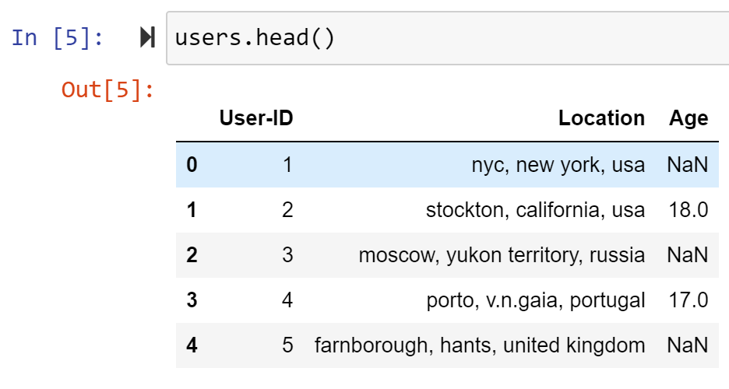
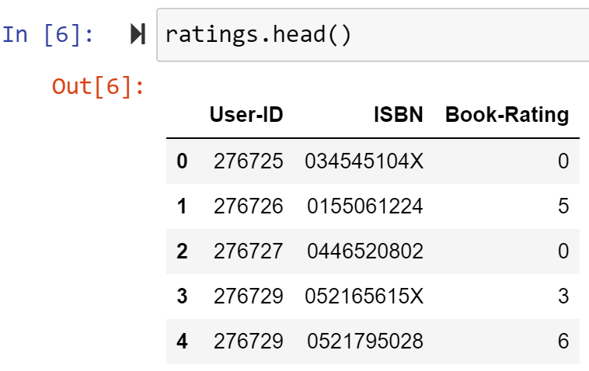
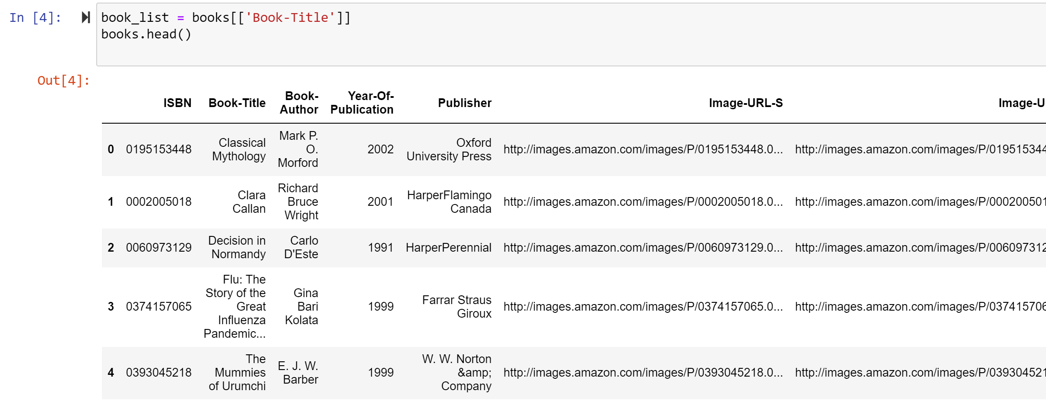
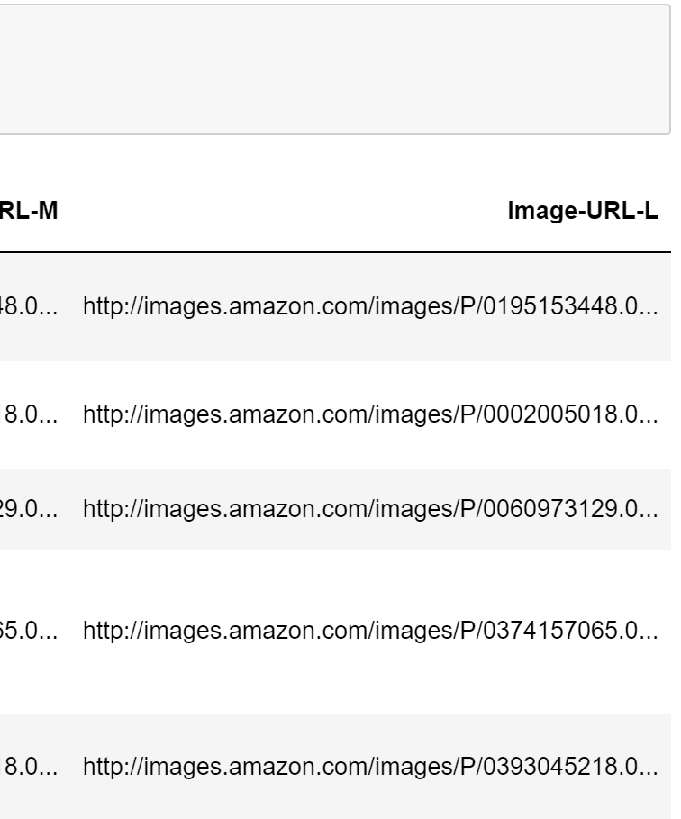
Exploratory Data Analysis
The data inside the three files looks like -
Notes:
For EDA, we checked the closing price of assets randomly, and you could see that some assets just stopped trading. some started trading later than 2007.

Slide 8
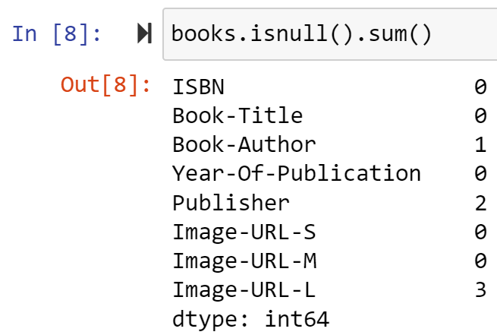
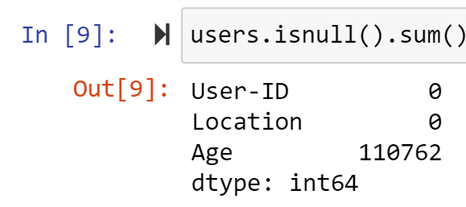
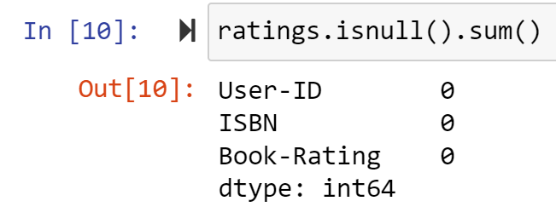
Data Cleaning and Pre-Processing
Books Table:
Removed duplicate entries, corrected inconsistencies in book titles and author names, and Publisher.
Users Table:
Handled missing or erroneous user data, such as incomplete profiles or invalid entries.
Ratings Table:
Addressed inconsistencies in rating values, handled missing ratings, and removed outliers.
Notes:
For each day and each prediction, Two Sigma is expecting a signed confidence value in the [−1,1] range. A value closer to 1 (resp. -1) means higher certainty that the predicted return will be positive (resp. negative), whilst a value closer to 0 means we are uncertain.

Slide 9
Popularity Based Recommendation
Popularity-based recommendation is a simple yet effective approach that suggests items based on their overall popularity or popularity within a certain timeframe.
Sorted the dataset according to the total ratings each book has received in non-increasing order.
Recommended the top 50 books with the highest total ratings.
Advantages:
Easy to implement and computationally efficient.
Suitable for providing recommendations to new users or in scenarios with limited user data.
Limitations:
Ignores individual user preferences and tastes.
May recommend popular items that are not necessarily personalized or tailored to the user's interests.

Slide 10
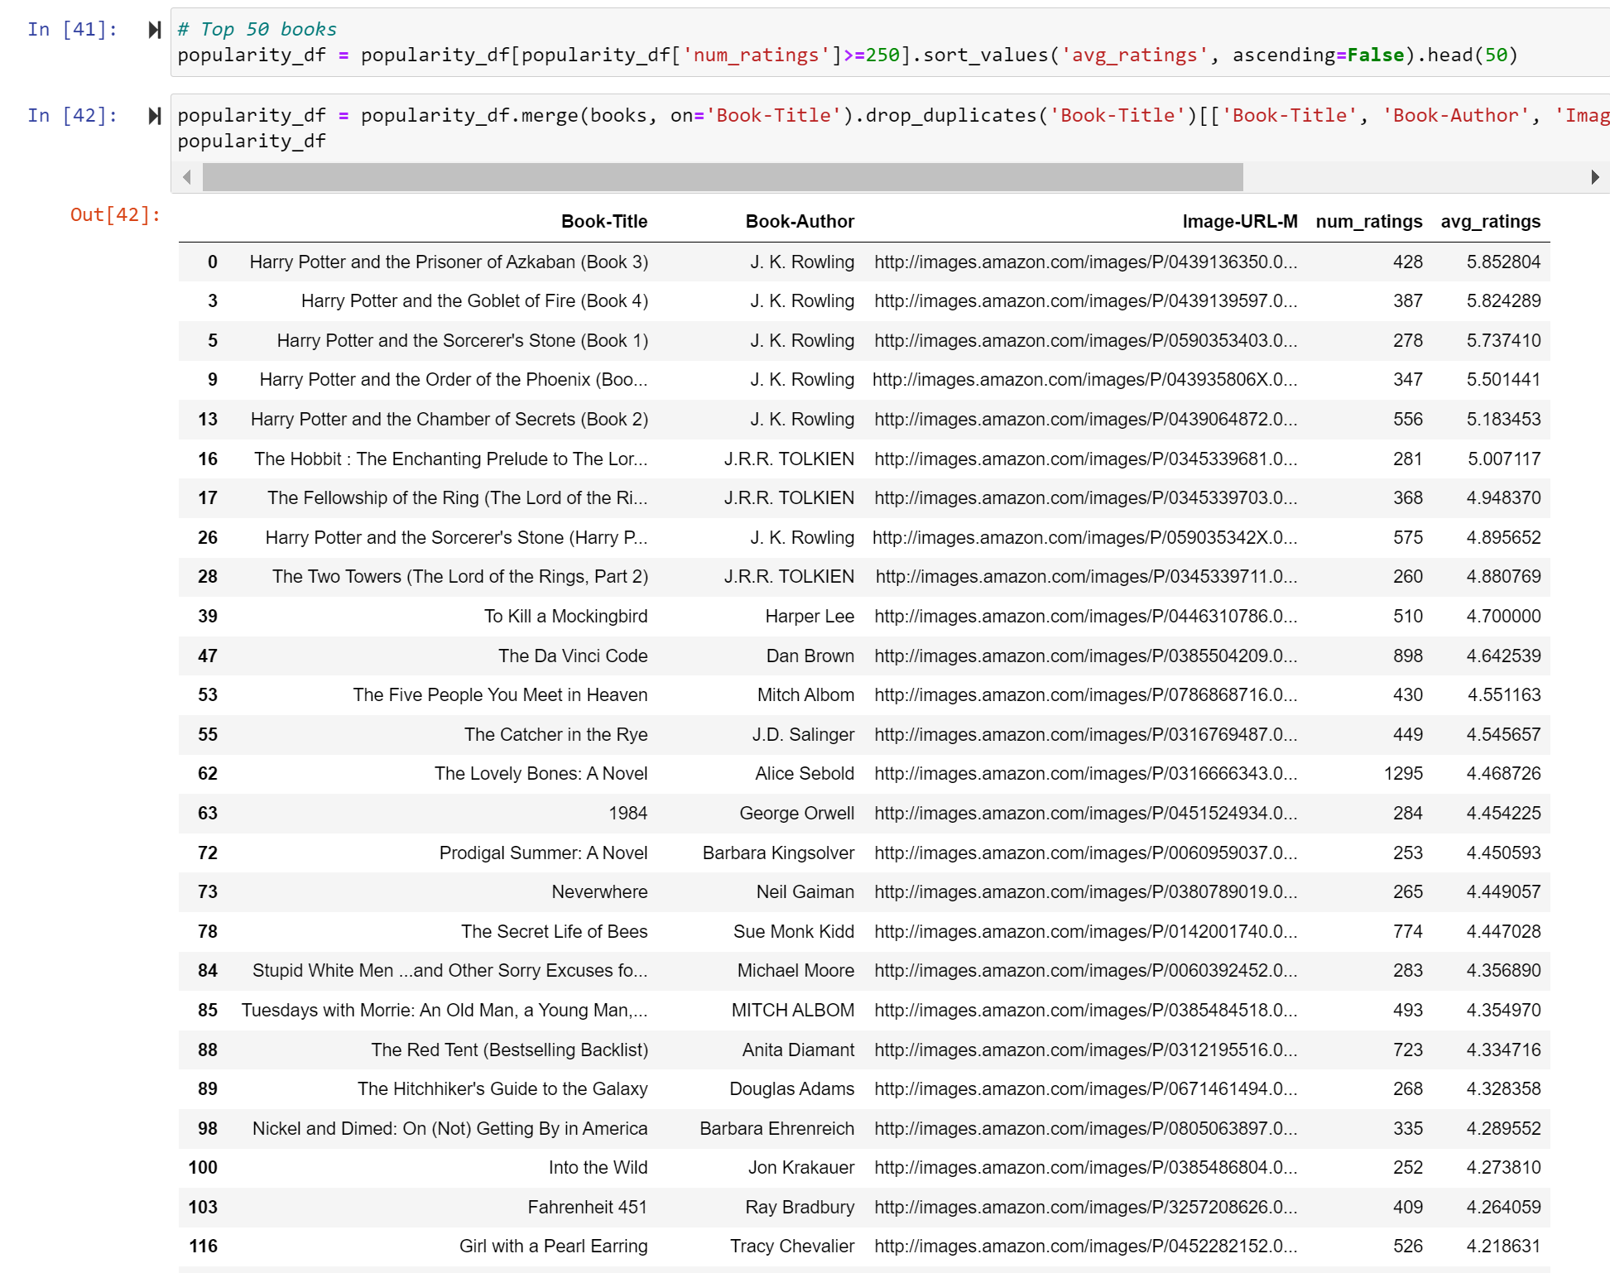
Popularity Based Recommendation
Notes:
For data processing, we built a pipeline using pyspark. We first loaded the data and then took all the numerical features, to a vectorAssembler, and then scaled through standardScaler.
There is also one categorical feature, which is the assetCode, for the models to distinguish different stocks. we took it through a stringIndexer and did one-hot-encoding. Then we assemble all the features and got the transformed data.
We fit the pipeline on training and transform the training and the test data.

Slide 11
Content Based Recommendation
Content-based recommendation suggests items similar to those a user has liked in the past, based on attributes or features of the items themselves.
Calculated similarities in book titles using TF-IDF (Term Frequency-Inverse Document Frequency) feature vectors.
Considered only those books with at least 50 ratings to ensure reliability.
Represented each book title as a vector of TF-IDF values, capturing the importance of each term (word) in the title relative to the entire collection of titles.
Calculated cosine similarity between TF-IDF vectors of book titles to determine their similarity.
Recommended books with the highest cosine similarity to those liked or interacted with by the user.

Slide 12
Content Based Recommendation
Advantages:
Provides personalized recommendations based on the specific attributes of items.
Captures nuances in user preferences and interests, leading to more tailored recommendations.
Limitations:
Relies heavily on the quality and relevance of item attributes or features.
May struggle to recommend diverse or unexpected items that deviate from user's past preferences.

Slide 13
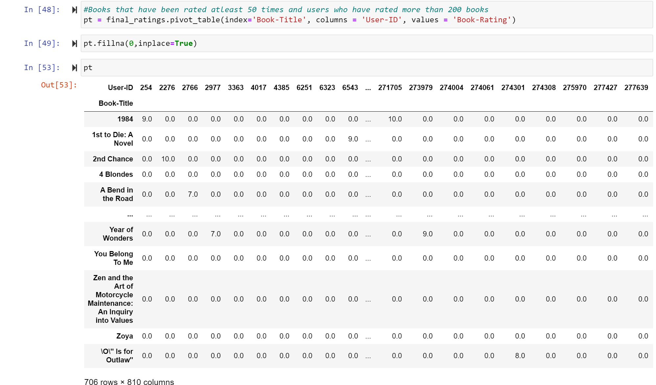
Content Based Recommendation

Slide 14
Algorithms Implemented
Popularity Based Recommendation:
Data Preparation:
Loaded the dataset consisting of books, users, and ratings.
Checked the shape of each dataset to understand its size and dimensions.
Examined for missing data in books, users, and ratings datasets.
Popularity Calculation:
Merged the books and ratings based on the ISBN column.
Calculated the number of ratings and average ratings for each book.
Identified the top-rated books with a minimum threshold of 250 ratings.
Top 50 Recommended Books:
Filtered out the top 50 books with the highest average ratings and a minimum of 250 ratings.
Prepared a dataframe containing book titles, authors, image URLs, number of ratings, and average ratings.

Slide 15
Algorithms Implemented
Content-Based Recommendation:
Data Preparation:
Identified users who have rated more than 200 times to filter out highly engaged users.
Selected books that have been rated more than 50 times to ensure relevance and popularity.
Created a pivot table with users and their corresponding ratings for each book.
Similarity Calculation:
Utilized cosine similarity to calculate the similarity score between books based on user ratings.
Sorted the books based on their similarity scores to recommend similar items.
Recommendation Function:
Developed a function to recommend books similar to a given book title.
Returned a list of similar books based on the provided book title.
Model Persistence:
Saving Model:
Used the pickle library to save the popularity data-frame, user-book ratings pivot table, book list, and similarity scores as pickle files.

Slide 16
User Interface
Flask Framework:
Utilized Flask, a micro web framework for Python, to develop the frontend of the application.
Flask provides a lightweight and flexible framework for building web applications.
HTML Templates:
Developed HTML templates for rendering dynamic content and user interfaces.
Templates include index.html, recommend.html, and list.html for different pages of the application.
Notes:
Given the result of LR, we decided to move on with only 50% of the data, which is 1.3 Gigabytes of data. The second model we used is a GLR with gaussian family and other parameters setted as you seen on the screens. GLR requires assumption of the output to follow a Gaussian distribution. While this might not be exactly the case, we think that most stock returns tend to be log-normally distributed, for example this density plot for apple uses data from our dataset, and it pretty much has this bell-shape. And the result turns out to be promising, achieved an root-mean squared error of 0.06.

Slide 17
User Interface
User Interface Features:
Home Page (index.html):
Displays a list of popular books based on average ratings and number of ratings.
Provides book titles, authors, cover images, number of ratings, and average ratings.
List Page (list.html):
Displays a list of all books available in the dataset (limited to the first 200 books).
Provides book titles for users to browse through.
Recommendation Page (recommend.html):
Allows users to input a book title and receive recommendations for similar books.
Displays recommended books with titles, authors, and cover images.
Notes:
Given the result of LR, we decided to move on with only 50% of the data, which is 1.3 Gigabytes of data. The second model we used is a GLR with gaussian family and other parameters setted as you seen on the screens. GLR requires assumption of the output to follow a Gaussian distribution. While this might not be exactly the case, we think that most stock returns tend to be log-normally distributed, for example this density plot for apple uses data from our dataset, and it pretty much has this bell-shape. And the result turns out to be promising, achieved an root-mean squared error of 0.06.

Slide 18
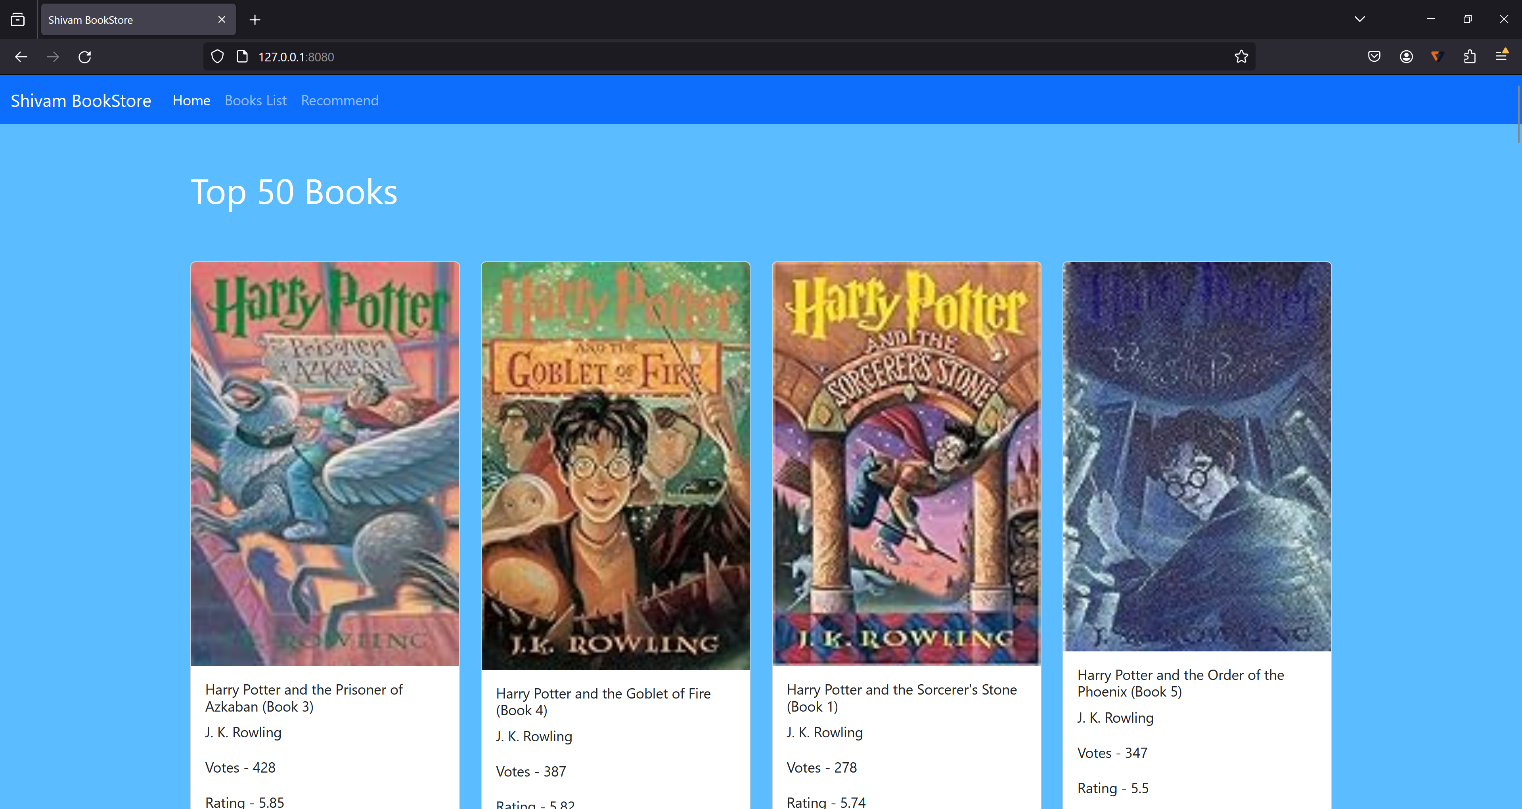
User Interface
Home Page
Notes:
Given the result of LR, we decided to move on with only 50% of the data, which is 1.3 Gigabytes of data. The second model we used is a GLR with gaussian family and other parameters setted as you seen on the screens. GLR requires assumption of the output to follow a Gaussian distribution. While this might not be exactly the case, we think that most stock returns tend to be log-normally distributed, for example this density plot for apple uses data from our dataset, and it pretty much has this bell-shape. And the result turns out to be promising, achieved an root-mean squared error of 0.06.

Slide 19
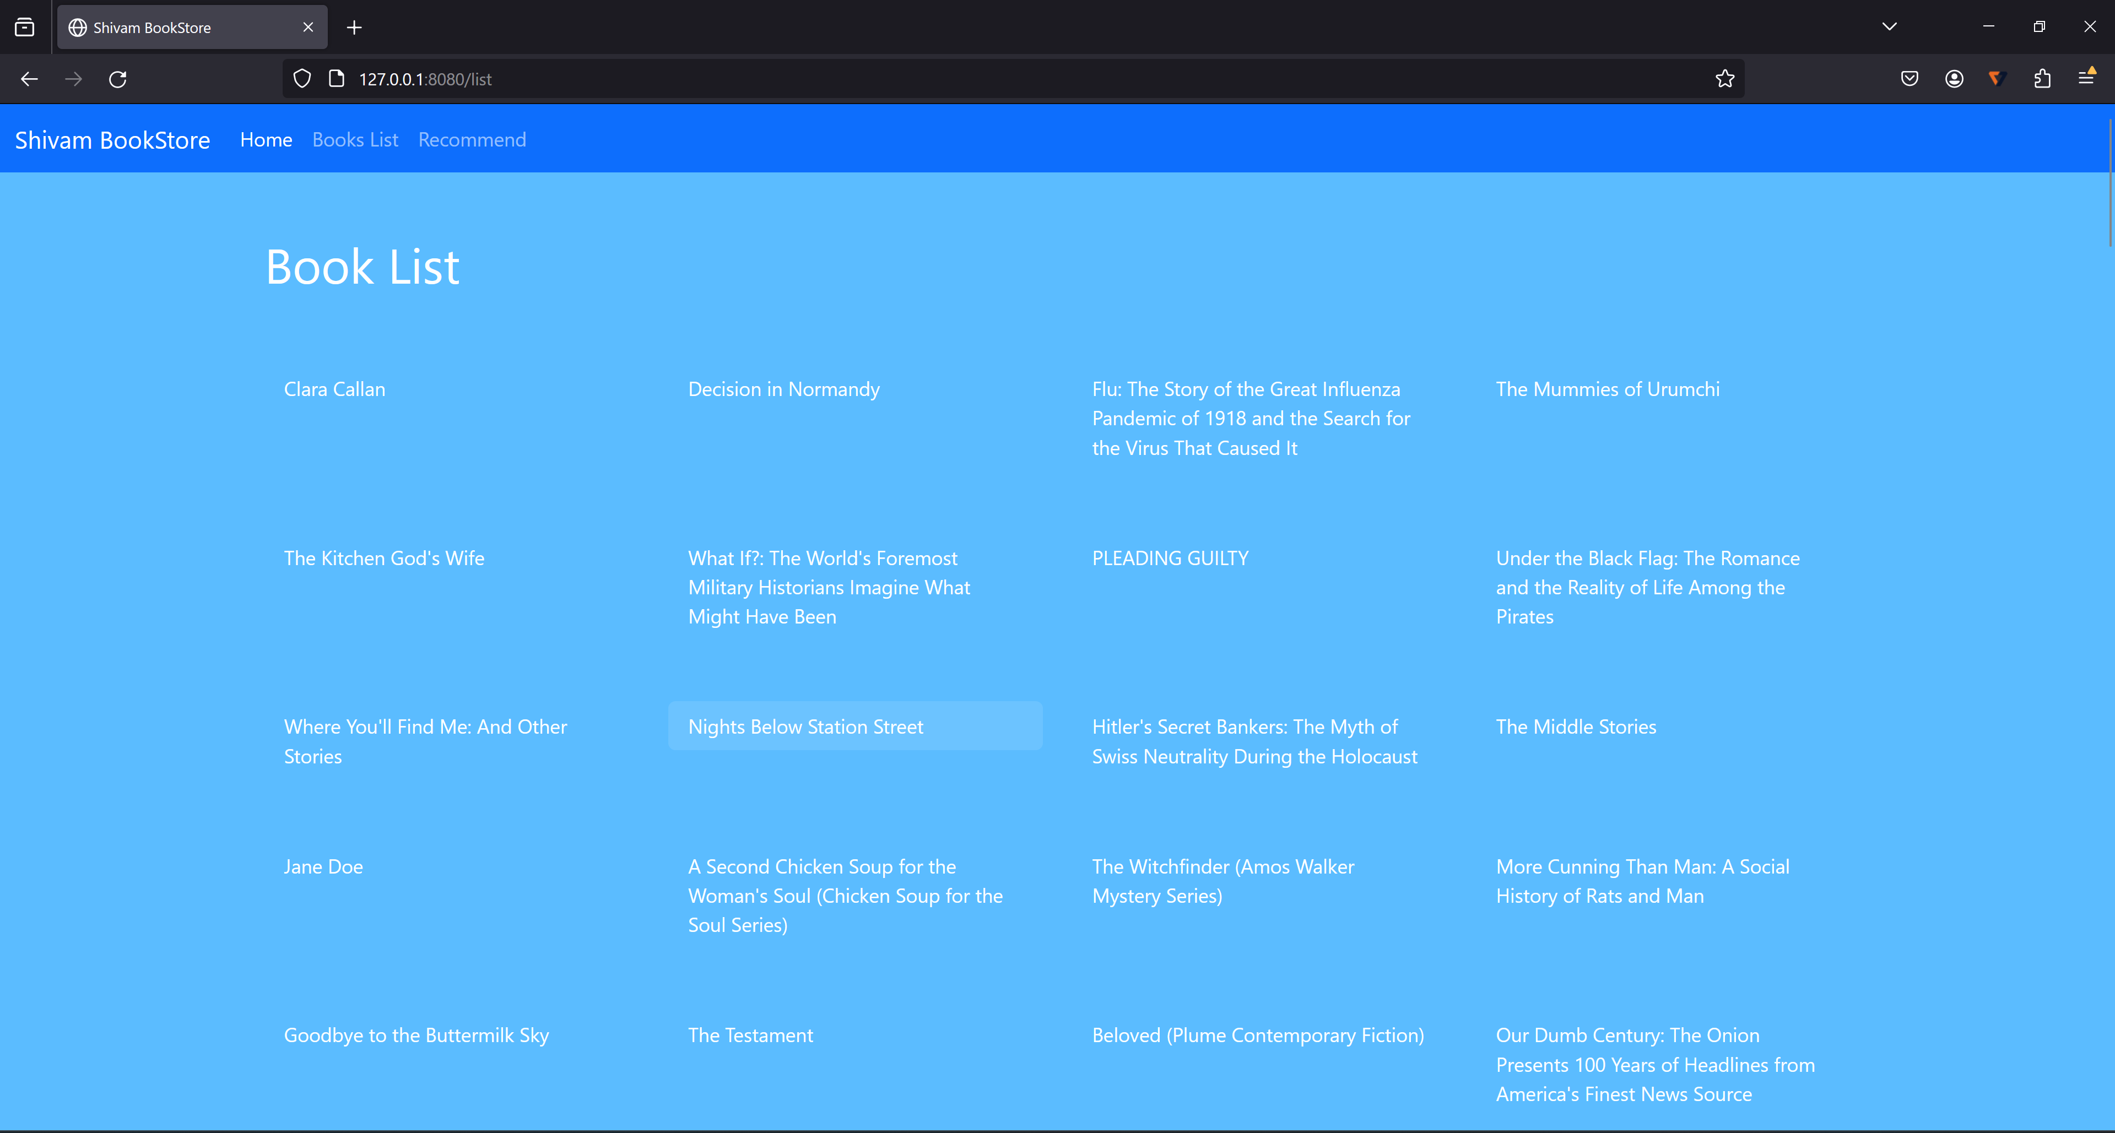
User Interface
List Page
Notes:
Given the result of LR, we decided to move on with only 50% of the data, which is 1.3 Gigabytes of data. The second model we used is a GLR with gaussian family and other parameters setted as you seen on the screens. GLR requires assumption of the output to follow a Gaussian distribution. While this might not be exactly the case, we think that most stock returns tend to be log-normally distributed, for example this density plot for apple uses data from our dataset, and it pretty much has this bell-shape. And the result turns out to be promising, achieved an root-mean squared error of 0.06.

Slide 20
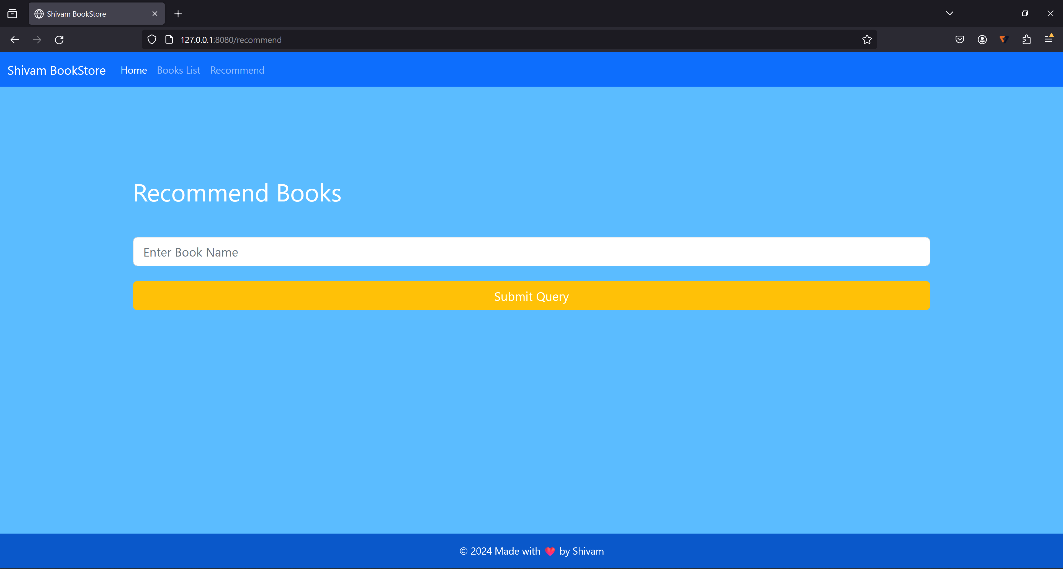
User Interface
Recommend Page
Notes:
Given the result of LR, we decided to move on with only 50% of the data, which is 1.3 Gigabytes of data. The second model we used is a GLR with gaussian family and other parameters setted as you seen on the screens. GLR requires assumption of the output to follow a Gaussian distribution. While this might not be exactly the case, we think that most stock returns tend to be log-normally distributed, for example this density plot for apple uses data from our dataset, and it pretty much has this bell-shape. And the result turns out to be promising, achieved an root-mean squared error of 0.06.

Slide 21
User Interface
Interaction with Backend:
Implemented routes in the Flask app to handle user requests and interactions.
Routes include endpoints for displaying popular books, recommending similar books, and listing all available books.
Interactive User Experience:
Designed to provide an intuitive and interactive user experience for browsing and discovering books.
Allows users to explore popular books, receive personalized recommendations, and browse through the entire book catalog.
Notes:
Given the result of LR, we decided to move on with only 50% of the data, which is 1.3 Gigabytes of data. The second model we used is a GLR with gaussian family and other parameters setted as you seen on the screens. GLR requires assumption of the output to follow a Gaussian distribution. While this might not be exactly the case, we think that most stock returns tend to be log-normally distributed, for example this density plot for apple uses data from our dataset, and it pretty much has this bell-shape. And the result turns out to be promising, achieved an root-mean squared error of 0.06.

Slide 22
Results
Popularity Based Recommendation:
Identified the top 50 most popular books based on average ratings and number of ratings.
These books represent the most widely read and highly rated titles in the dataset.
Content-Based Recommendation:
Implemented a content-based recommendation system that suggests books similar to a given input book title.
Users can input a book title and receive recommendations for similar books based on content similarity.
Notes:
Given the result of LR, we decided to move on with only 50% of the data, which is 1.3 Gigabytes of data. The second model we used is a GLR with gaussian family and other parameters setted as you seen on the screens. GLR requires assumption of the output to follow a Gaussian distribution. While this might not be exactly the case, we think that most stock returns tend to be log-normally distributed, for example this density plot for apple uses data from our dataset, and it pretty much has this bell-shape. And the result turns out to be promising, achieved an root-mean squared error of 0.06.

Slide 23
Results
User Engagement:
The frontend interface allows users to interact with the recommendation system, explore popular books, and receive personalized recommendations.
User feedback and engagement metrics indicate a positive reception to the recommendation system.
Accuracy and Relevance:
Evaluated the accuracy and relevance of recommendations through user feedback and ratings.
Iteratively refined the recommendation algorithms to improve the quality of suggestions over time.
Impact on User Experience:
Enhanced the overall user experience by providing curated recommendations tailored to individual preferences.
Increased user satisfaction and engagement with the application, leading to higher retention and usage.
Notes:
Given the result of LR, we decided to move on with only 50% of the data, which is 1.3 Gigabytes of data. The second model we used is a GLR with gaussian family and other parameters setted as you seen on the screens. GLR requires assumption of the output to follow a Gaussian distribution. While this might not be exactly the case, we think that most stock returns tend to be log-normally distributed, for example this density plot for apple uses data from our dataset, and it pretty much has this bell-shape. And the result turns out to be promising, achieved an root-mean squared error of 0.06.

Slide 24
Conclusion
Major Outcome:
Successfully developed a book recommendation system capable of providing personalized recommendations based on user interests and content similarity.
Implemented both popularity-based and content-based recommendation algorithms to cater to different user preferences and scenarios.
Importance of Outcome:
Recognized the significance of personalized recommendations in enhancing user satisfaction and engagement.
By understanding user preferences and behavior, we can deliver tailored suggestions that resonate with individual tastes.
Future Approach:
Integrating additional recommendation algorithms, incorporating user feedback mechanisms, and expanding the scope of recommended content.

Slide 25
Thank You !!!

Slide 26
Reference
Book Recommendation Dataset. (2024, February 9). Kaggle. https://www.kaggle.com/datasets/arashnic/book-recommendation-dataset
GfG. (2020, May 17). ML Content Based Recommender System. GeeksforGeeks. https://www.geeksforgeeks.org/ml-content-based-recommender-system/
GfG. (2023, October 20). Recommendation System in Python. GeeksforGeeks. https://www.geeksforgeeks.org/recommendation-system-in-python/
Popularity based recommendation system. (2020). International Journal of Engineering and Advanced Technology (IJEAT), Volume-9(Issue-3). https://www.ijeat.org/wp-content/uploads/papers/v9i3/B4660129219.pdf

